Slide 1

Principles of Program Design: Problem Solving with JavaScript
Chapter 11
Building Programs

Slide 2
Objectives
In this chapter, you learn to:
Look for the main purpose of a program
Design programs by matching structures and tools to the problems to be solved
Determine whether a program fits the typical data-processing model
Apply programming tools to new situations

Slide 3
Objectives (cont’d.)
Use top-down design and module refinement to develop complete programs
Use thorough program-testing techniques
Design comprehensive data to test a program

Slide 4
Seeing the Big Picture
First step: understand the program’s purpose
Types of tasks
  Performing calculations
  Calculating statistics
  Generating reports
  Processing orders
Look for overall shape, or pattern
  Prepare, process data, finish-up

Slide 5
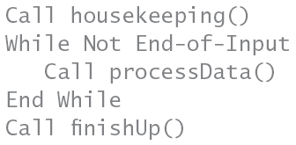
Seeing the Big Picture (cont’d.)
Housekeeping module
  Preparation tasks
  Performed once
Processing module
  Repeated for each instance of input data
Finish-up module
  Performed once

Slide 6
Matching Tools and Techniques with Problems
Programs built with combination of three control structures
  Sequence, selection, repetition
Module calls can be put in place
  Code can be developed later

Slide 7
Matching Tools and Techniques with Problems (cont’d.)
Example 1: total number of books donated, given number of books per donor
  Data entry for each donor indicates loop
  Number of input items unspecified:
    Use sentinel value
  While loop or Do While loop can be used
  Accumulator variable to total number of books
  One possible solution on next slide

Slide 8
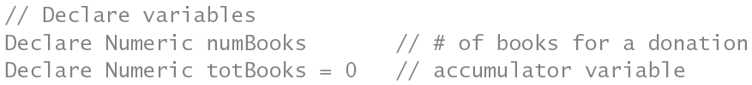
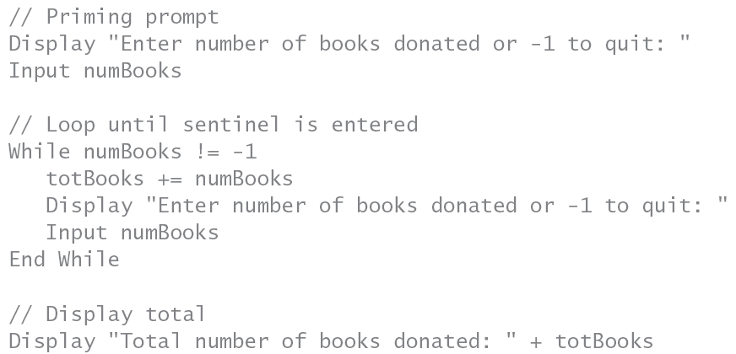

Slide 9
Matching Tools and Techniques with Problems (cont’d.)
Example 2: enter and display amount of rainfall each day in April and display percentage of month’s total rainfall
  Use loop: several items need to be entered
  Number of inputs known: use For loop
  Array to store daily rainfall amounts
    Until total is computed
    Percentages can then be calculated
    Add 1 to array subscripts to match day of month
  One possible solution on next slide

Slide 10
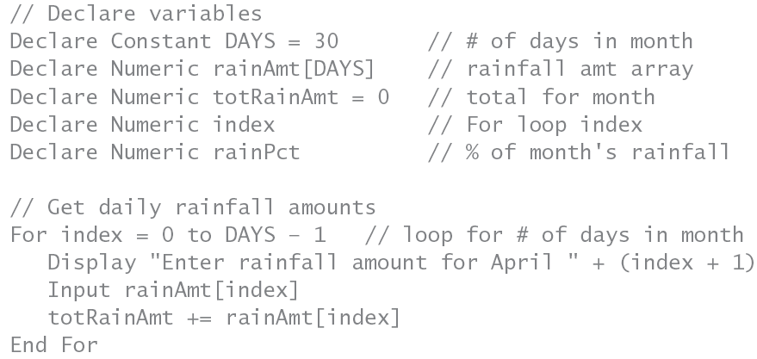
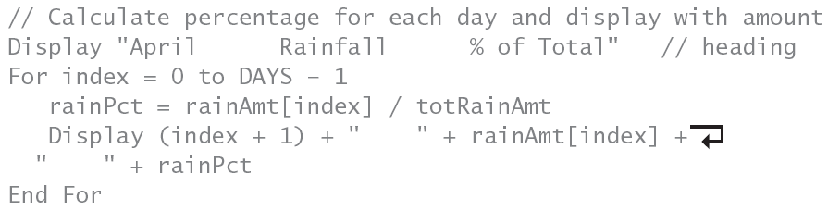

Slide 11
Matching Tools and Techniques with Problems (cont’d.)
Uses for control structures and other tools
  Sequence structure
    Statements performed in order
  Selection structure
    Choice between two courses of action based on condition evaluation
  Repetition structure
    Action taken multiple times
  Modules and functions
    Simplify and provide reusable code

Slide 12
Matching Tools and Techniques with Problems (cont’d.)
Control structures and other tools (cont’d.)
  Classes and objects
  Graphical user interfaces
    Create attractive environment for users
  Pseudocode
    Develop algorithm steps independent of language
  Flowcharts
    Graphical representation of algorithm steps
  IPO charts
    List inputs, processing steps, outputs

Slide 13
Matching Tools and Techniques with Problems (cont’d.)
Control structures and other tools (cont’d.)
  Truth tables
    List logical results of combining conditions
  Decision tables
    Specify actions for various condition combinations
  Binary trees
    Graphical representation of outcomes
  Hierarchy charts
    Show relationships between modules

Slide 14
Matching Tools and Techniques with Problems (cont’d.)
Control structures and other tools (cont’d.)
  Menus
    Restrict user choice of possible actions
  Data validation
    Prevent or reduce user errors
  Arrays
    Store lists of similar variables
  Special variable types
    Counters, sentinels, accumulators, subscripts

Slide 15
Matching Tools and Techniques with Problems (cont’d.)
Example 3: determine student letter grade from percentage and display cumulative totals
  Multiple data items to enter indicates loop
  Number of inputs unknown
    While or Do While loop with sentinel value
  If/Else If statements can be used to determine letter grades
  Accumulator to count occurrences of each grade
    Or use parallel arrays
  Solution shown on next two slides

Slide 16
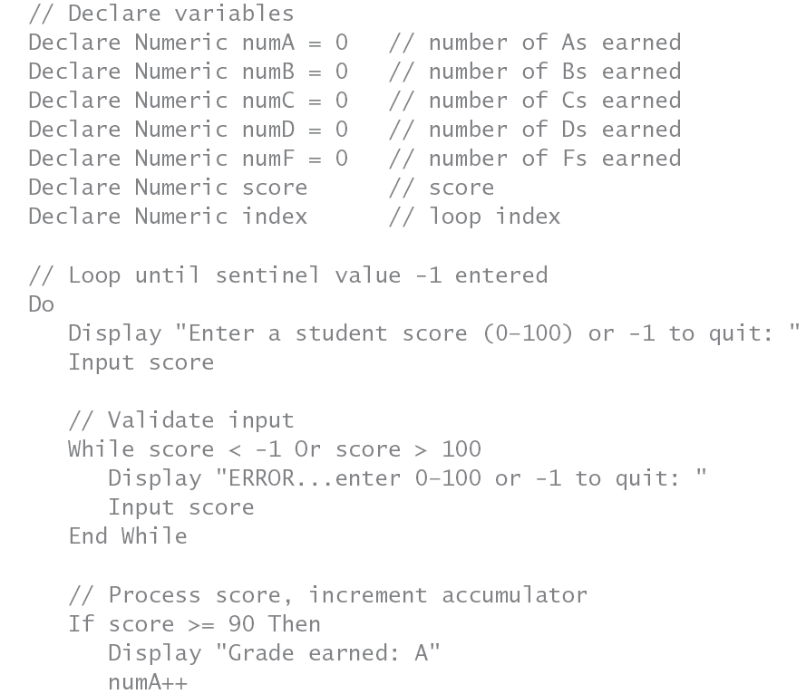
continues
continues

Slide 17
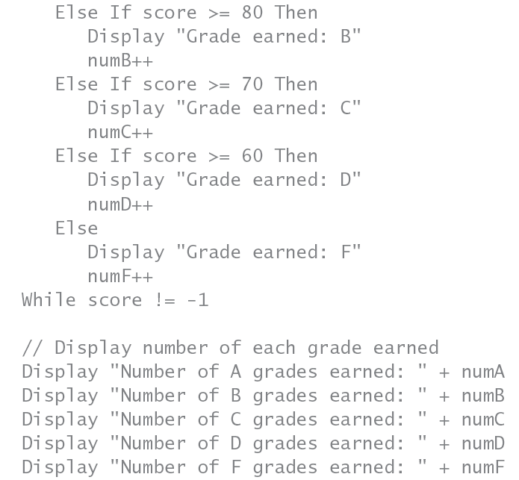

Slide 18
Matching Tools and Techniques with Problems (cont’d.)
Applying tools to new situations
  Consider all aspects of problem:
    Before outlining algorithm
Example: shuffle card deck and deal cards to two players
  Items to consider
    How to represent deck
    How to determine card point values
    How to simulate shuffling
    How to distribute cards to players

Slide 19
Matching Tools and Techniques with Problems (cont’d.)
Card shuffling example
  Represent deck as one-dimensional array
    Elements contain card name and suit
  Card values: use If/Else or Case structure
    Or use parallel array
  Players’ hands can be stored as arrays
  Shuffling: use random number generator
    Use array to keep track of values already assigned
  Use For loop to deal cards
  Solution shown on next two slides

Slide 20
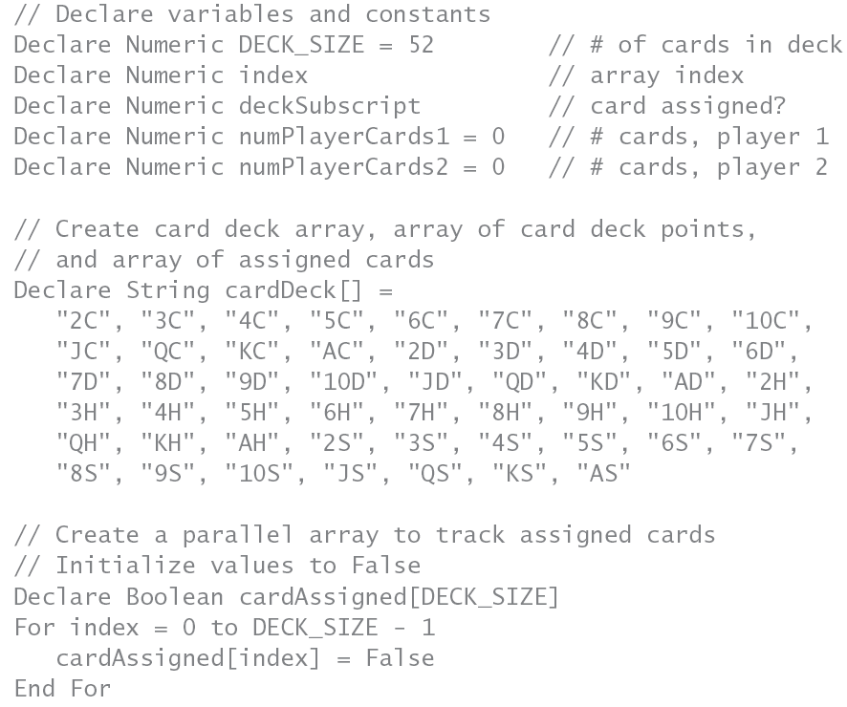
continues

Slide 21
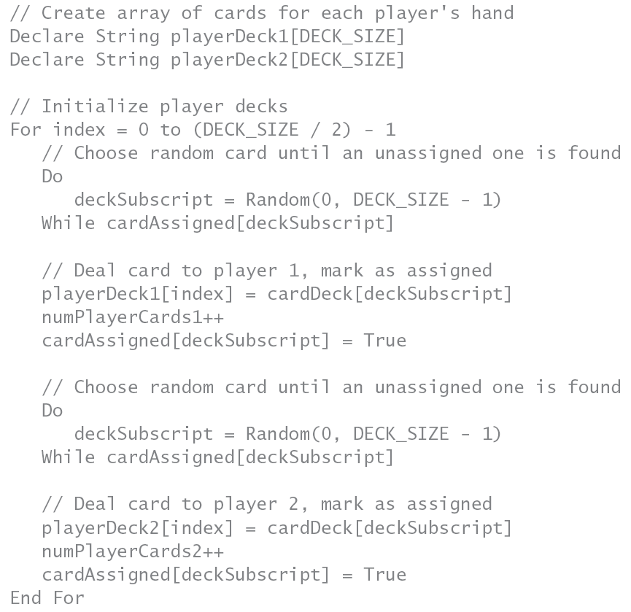

Slide 22
Top-Down Design and Stubs
Example 4: calculate user-selected statistics on number sets
  Menu is suitable for input structure
    User can make repeated choices
  Modules used to display menu:
    And process user’s choices
  See solution program on pages 426-430

Slide 23
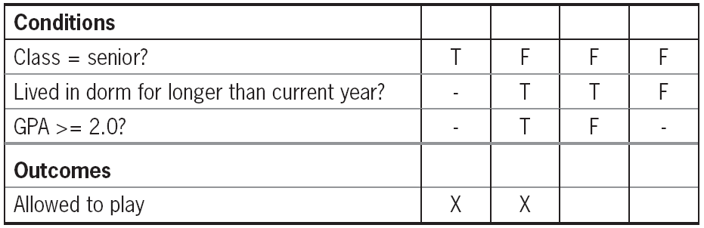
Top-Down Design and Stubs (cont’d.)
Example 5: determining tournament eligibility
  Combination of conditions
    Use decision table or binary tree
Table 11-2 Decision table for allowing a student to play in the tournament (final)

Slide 24
Thorough Program Testing and Comprehensive Data Sets
Modules must be tested by themselves:
  And with other modules
Data sets
  Data values created for testing program
  Include all possible variations you can think of
  Test values at the limits (borders):
    Of condition evaluation
  Check for nonnumeric, empty, or null data

Slide 25
Thorough Program Testing and Comprehensive Data Sets (cont’d.)
Online JavaScript resource:
  www.w3schools.com
Different possibilities for user number entry
  User enters value number and clicks OK
  User enters invalid number and clicks OK
  User does not enter value and clicks OK
    Value converted is NaN
  User clicks cancel
    Text variable is considered null
    Value converted is NaN

Slide 26
Thorough Program Testing and Comprehensive Data Sets (cont’d.)
Test module interaction with other modules
  Try all kinds of argument values
    Incorrect data types
    Out of order arguments
    Wrong number of arguments
  Ensure program can handle exceptions
Complete Program 11-1 on pages 433-434

Slide 27
Field Testing
Software engineering
  Methods, best practices, and tools:
    For professional software development
Field testing
  Running a program in environment:
    Set up to simulate real-world conditions
  Measure processing time and throughput
  Survey users for suggestions

Slide 28
Field Testing (cont’d.)
Recommended practices
  Peer review of comments for understandability
  Peer review of program operation
  Challenge peers to “break” program
    Check for effective error handling

Slide 29
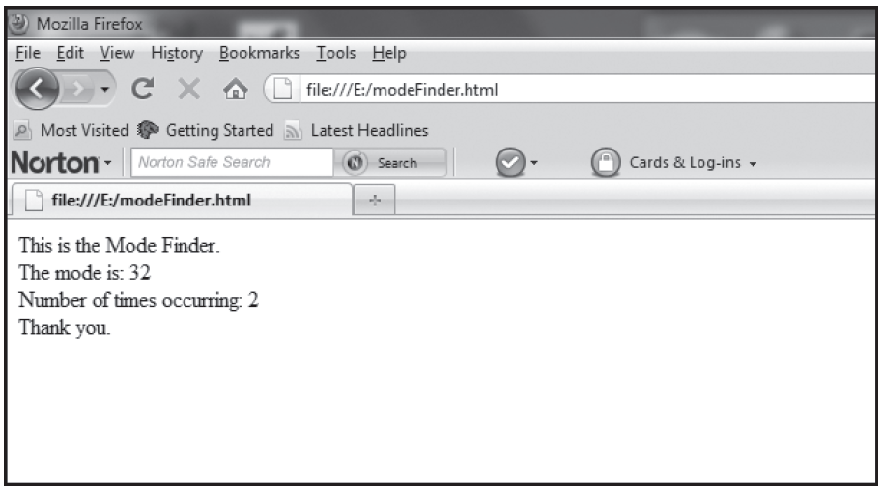
Field Testing (cont’d.)
Complete Programmer’s Workshop on pages 436-440
  Then convert to JavaScript
Figure 11-1 The modeFinder.html program with one mode

Slide 30
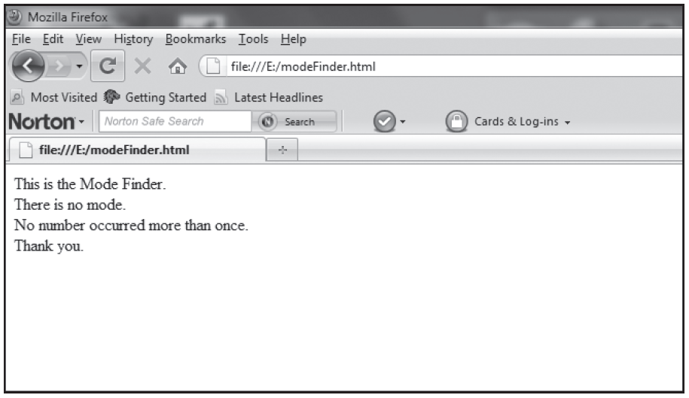
Field Testing (cont’d.)
Test what happens when there is no mode
  Use numbers 4, 6, 3, 2, 9, 7, and 5
Figure 11-2 The modeFinder.html program with no mode

Slide 31
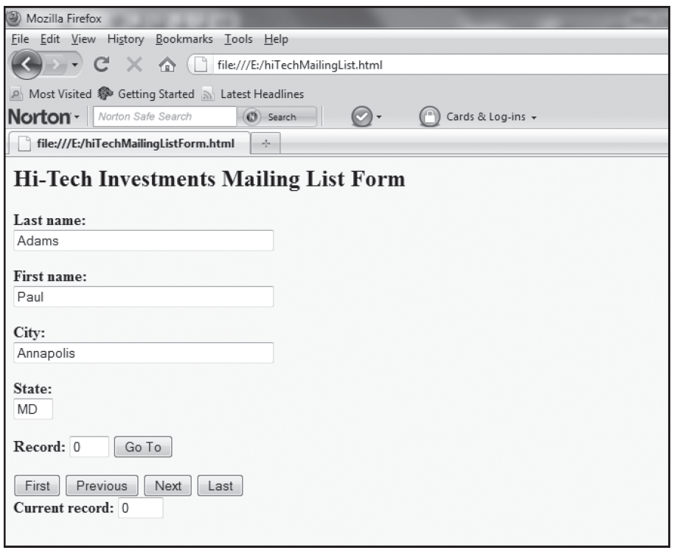
Field Testing (cont’d.)
Complete Object Lesson on pages 442-447
Figure 11-5 The hiTechMailingList.html program in a Web browser

Slide 32
Summary
Programming requires understanding the problem
  Knowing what tools are available
  Selecting appropriate tools
Typical data-processing program steps
  Preparation, processing, and finish-up
Top-down design
  Proven development methodology
  Allows detail refinement to occur over time

Slide 33
Summary (cont’d.)
Module and program testing
  Ensures program handles invalid data correctly
  Ensures parts interact with each other correctly
  Data sets are used for testing purposes
  Field testing the program
    Preparing for business, industry, and public use

